Slide 1
Confounded Cuisiner: Learning Cuisines Through Unsupervised Learning
Stefan Heinze
Data Challenge Week 6

Slide 2

Task
Given a set of recipes whose cuisine types are not given, is it possible to figure out which cuisine each recipe belongs to?
Sub-problems:
What are the driving ingredients for each cuisine?
How would you write a guide for an outsourcing team to label cuisines by hand?
Can you design this to be robust enough to understand similarities / substitutions between ingredients?

Slide 3
Outline
Dataset and data challenges
Non-ingredient ingredients
Usage of singe-word ingredients vs. multi-word ingredients
Modeling approach
TF-IDF
K-means clustering
Identified cuisines
Distinguishing ingredients

Slide 4
Dataset and data challenges

Slide 5
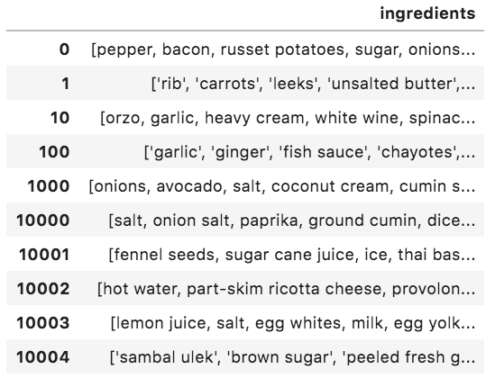
Many non-ingredient ingredients in dataset
~40,000 recipes
Non-ingredient ingredients:
Russet potatoes
Unsalted butter
Ground cumin
Diced onion
Peeled fresh garlic
Sugar cane juice
Lemon juice
~3000 single-word ingredients, ~7000 multi-word ingredients

Slide 6
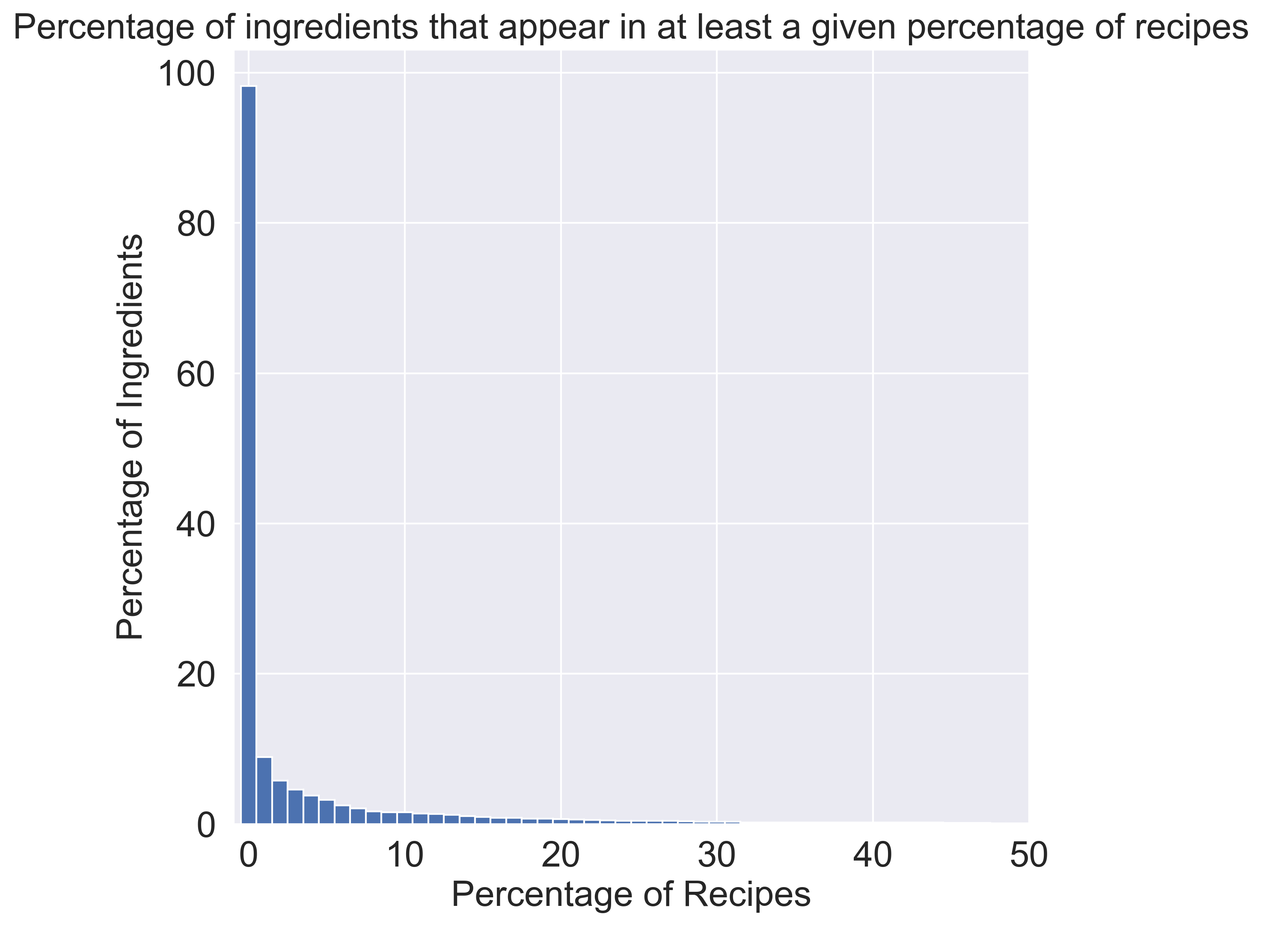
Remove common ingredients and rare ingredients
Manually removed from the top 200 most common ingredients things like:
Pepper, salt, water, oil
Red, green, purple, white
Shredded, diced, chopped
Removed any ingredients not appearing in at least 0.5% of recipes (this deserves special discussion in Q&A)
Removed English stopwords
3000 ingredients -> 381 ingredients
In the future, would stem/lemmatize words.

Slide 7
Modeling approach

Slide 8
TF-IDF and K-means clustering
(Binarized) TF-IDF utilized to reduce weights of ingredients utilized commonly throughout all cuisines
K-means clustering utilized to decide # of clusters (also tried GMM, which can be discussed in Q&A).
How to decide # of clusters?

Slide 9
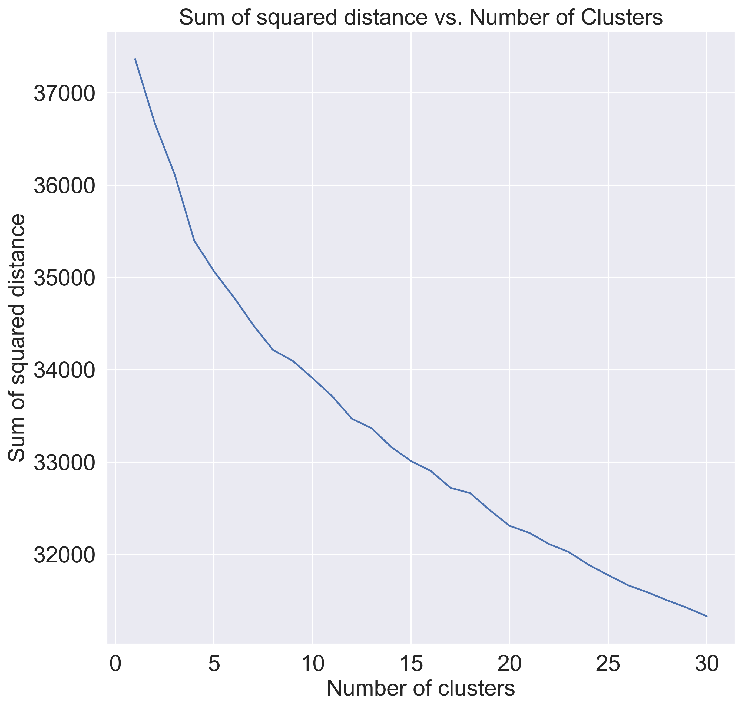
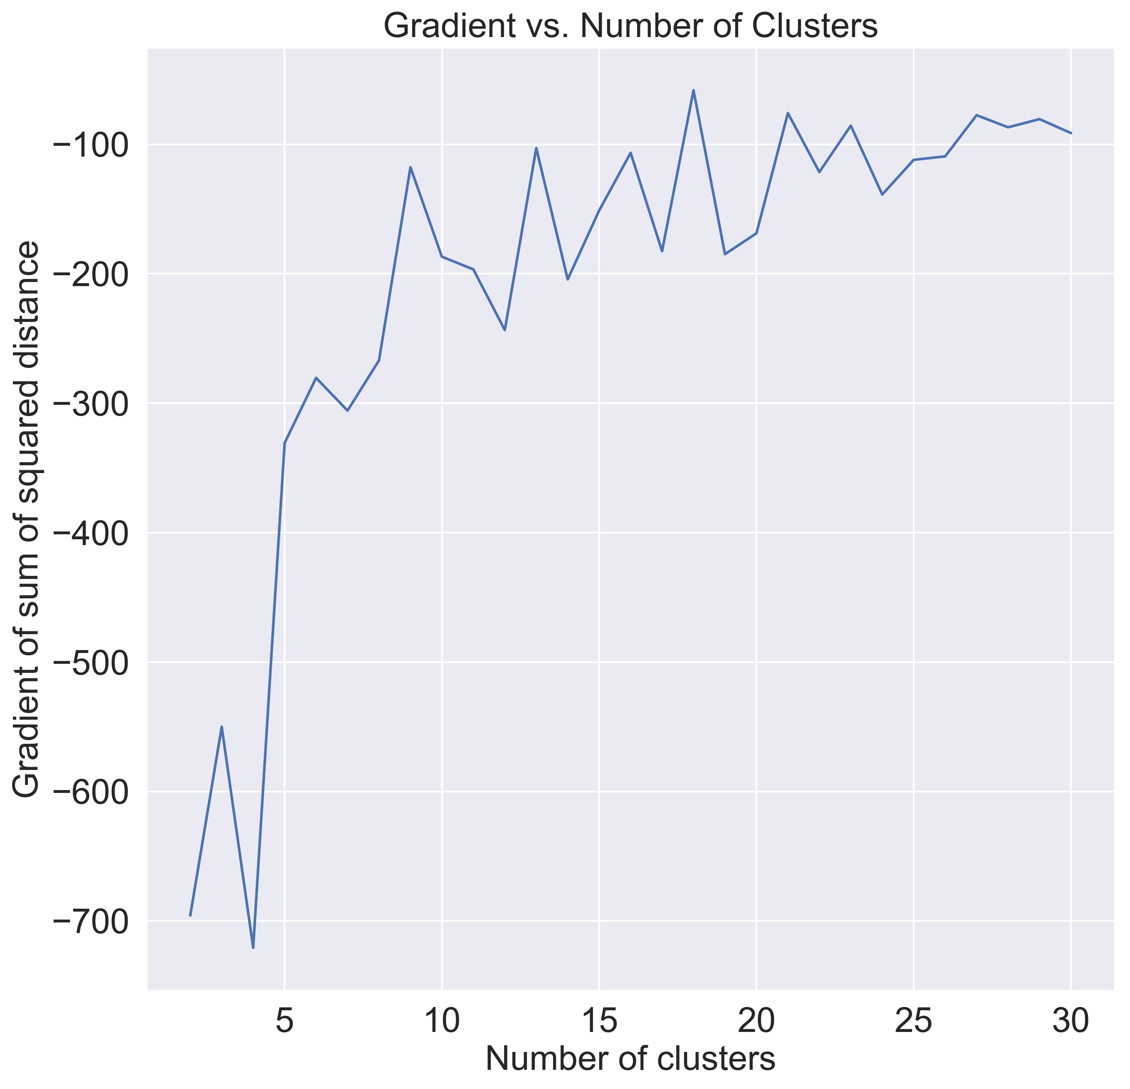
Number of clusters assessed through “elbow” curve

Slide 10
Identified Cuisines

Slide 11
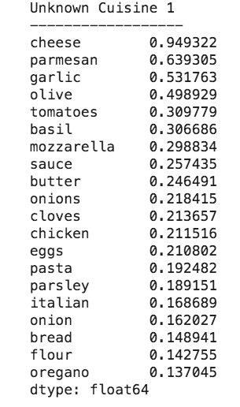
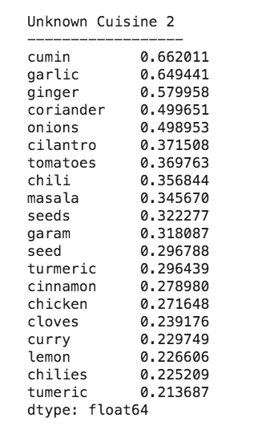
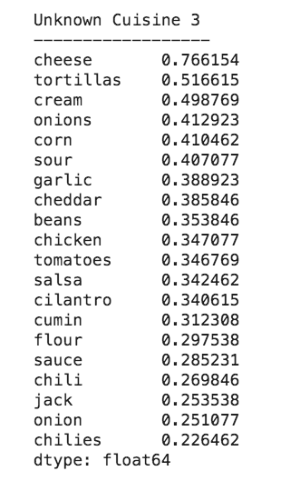
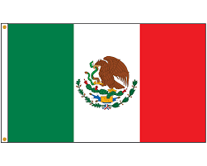


Assigning cluster names is done manually
Identified cuisines:
Italian
Indian
Mexican
Mediterranean
East Asian
American
Desserts
Southeast Asian

Slide 12
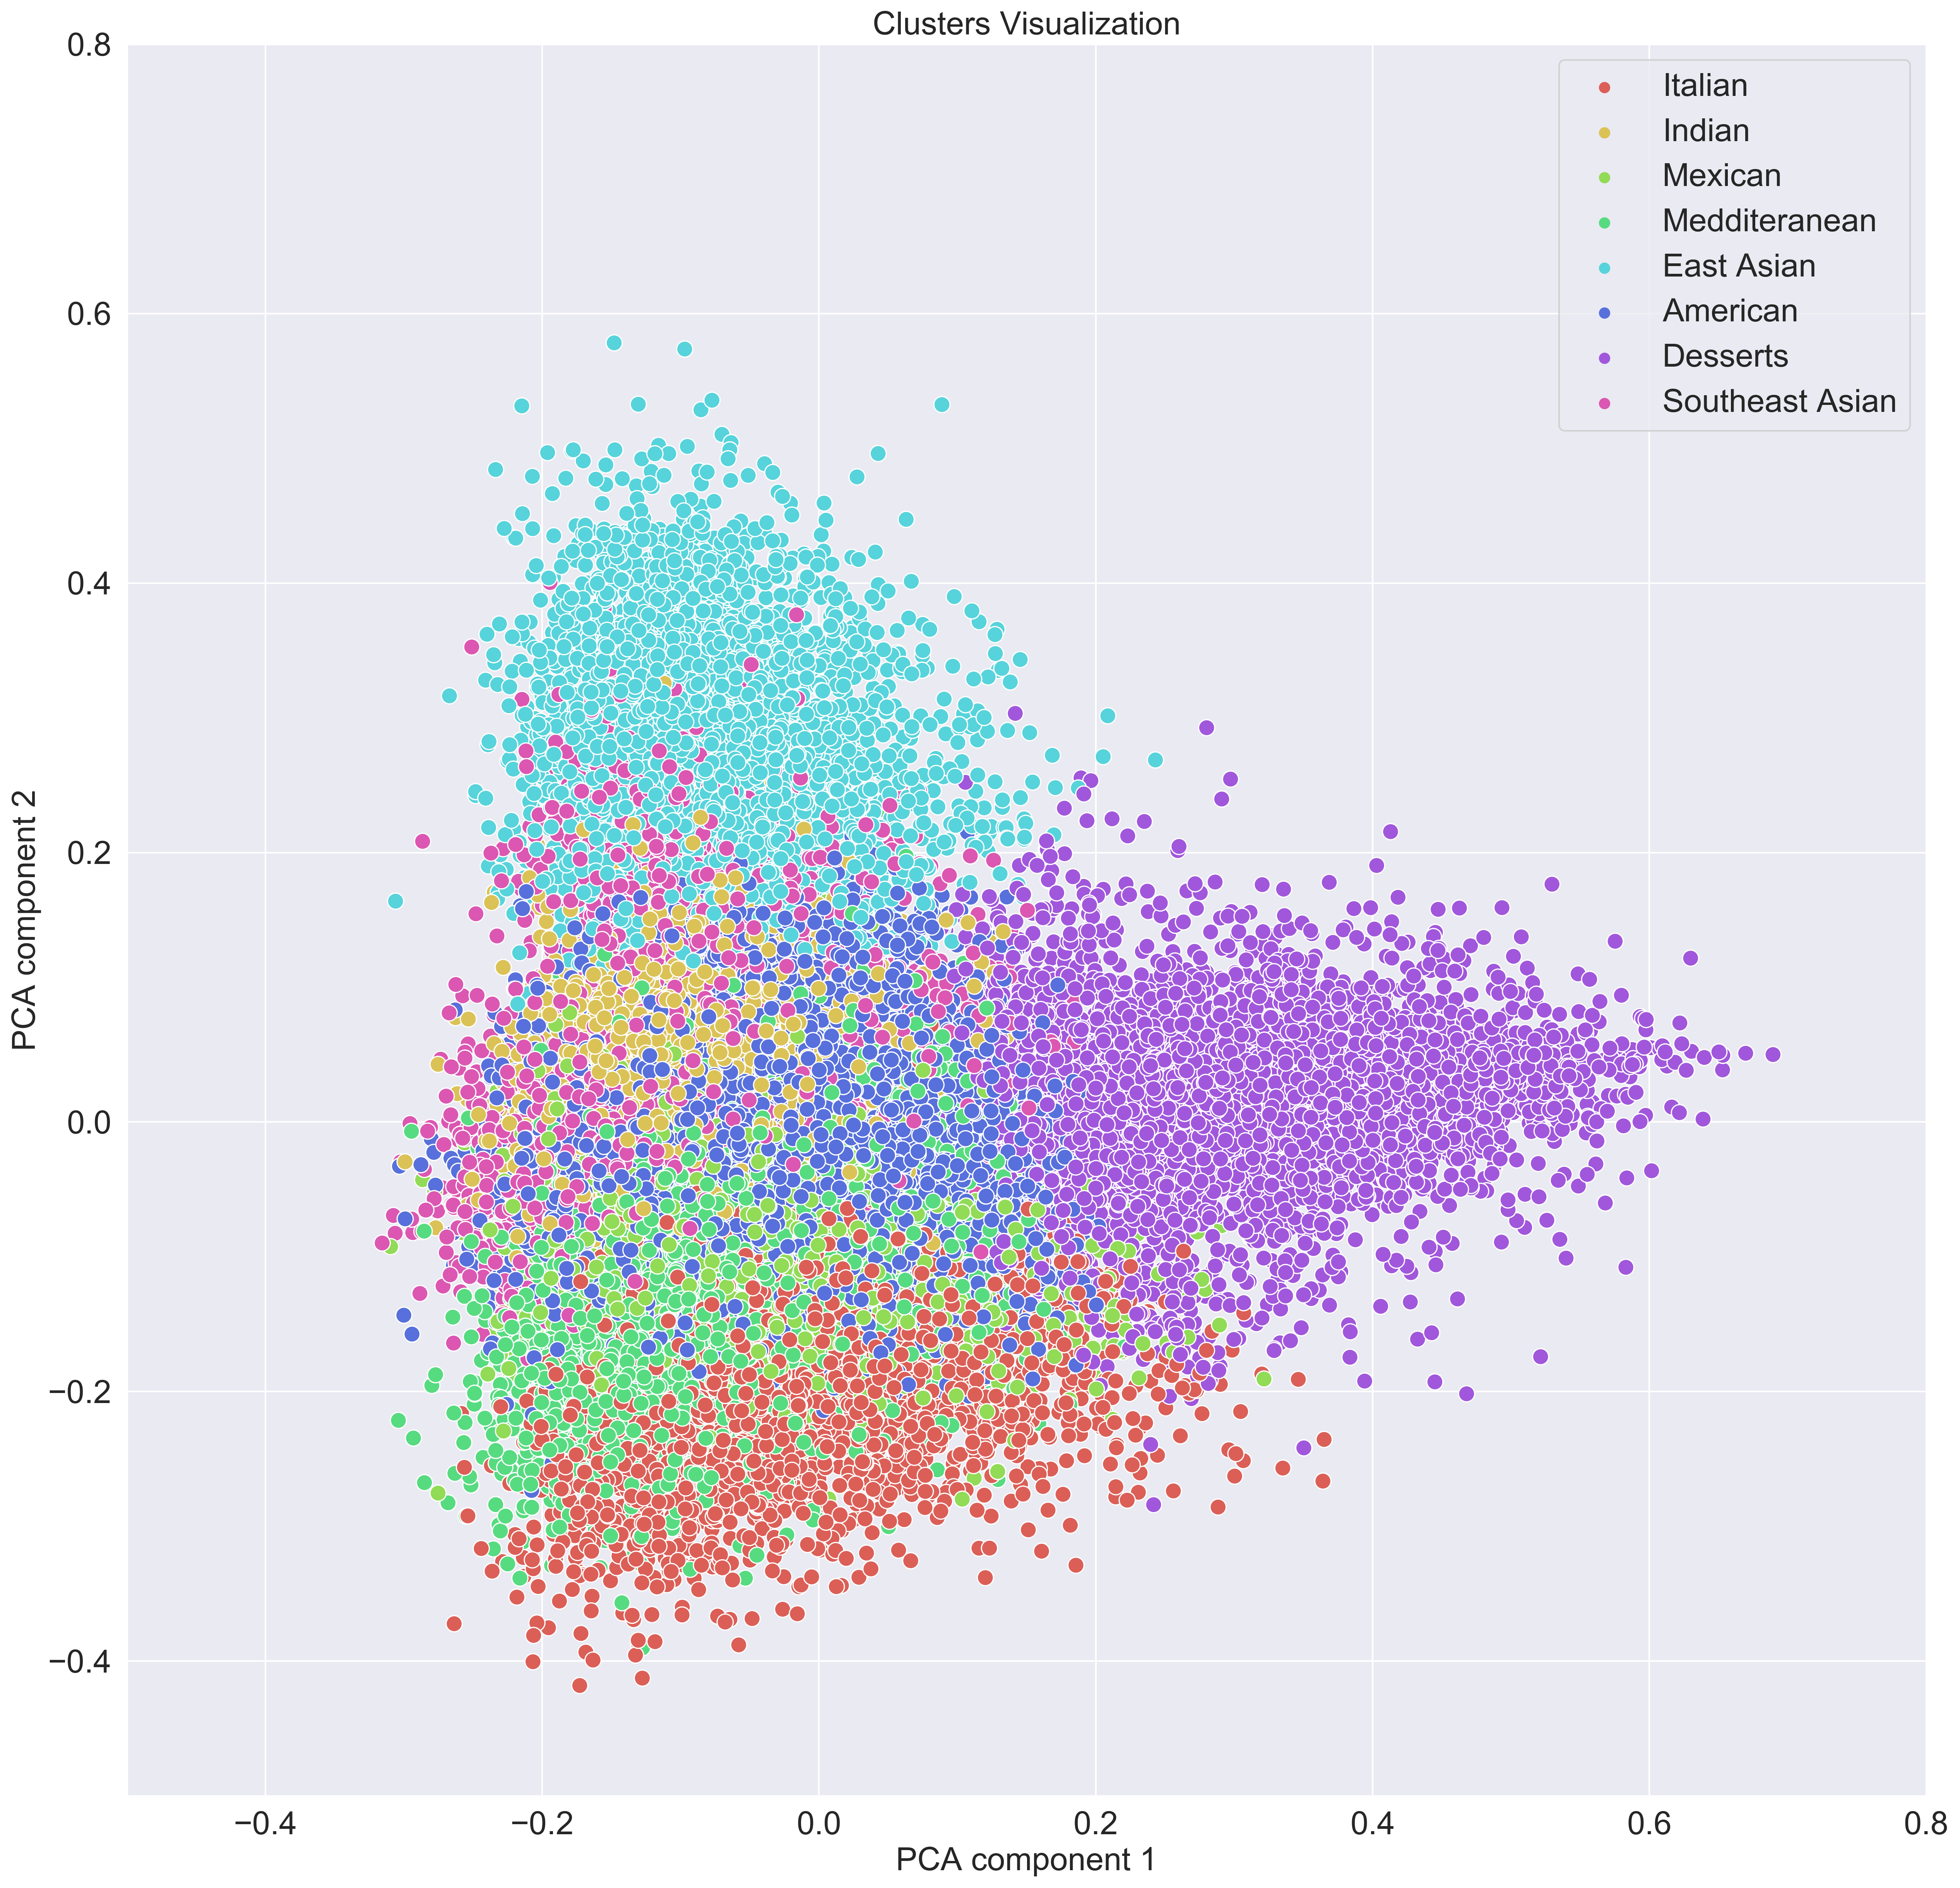
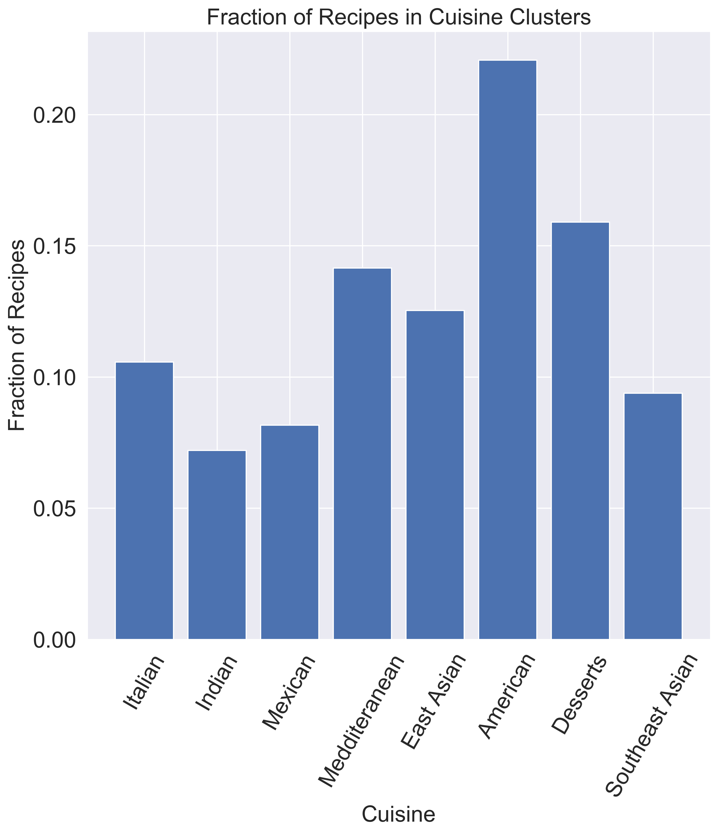
Difficult to tell if clusters are well separated

Slide 13
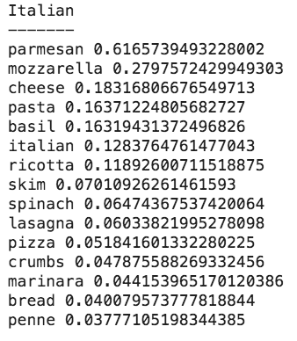
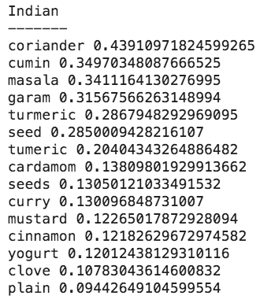
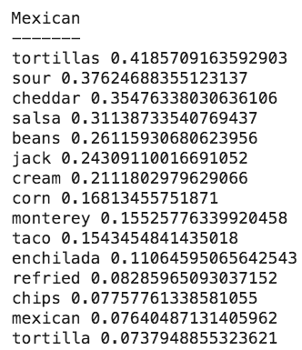
Distinguishing ingredients
Distinguishing ingredients in a particular cuisine were identified by comparing the fraction of recipes that contain an ingredient within the cuisine of interest to the maximum fraction of recipes that contain that same ingredient in all other cuisines.
These are ingredients that should be used as guidelines for hand labeling. If a recipe contains multiple of these ingredients, the recipe likely belongs to these cuisines.

